Slide 1
ADVANCED PROGRAMING PRACTICES
SOEN 6441 - Advanced Programming Practices
Design patterns
Joey Paquet, 2006-2014

Slide 2
SOEN 6441 - Advanced Programming Practices
Design patterns
“Each pattern describes a problem which occurs over and over again in our environment, and then describes the core of the solution to that problem, in such a way that you can use this solution a million times over, without ever doing it the same way twice.” [Christopher Alexander – late 1970s]
  A Pattern Language (1977)
  A Timeless Way of Building (1979)
Design patterns capture the best practices of experienced object-oriented software developers.
Design patterns are solutions to general software development problems.
Joey Paquet, 2006-2014

Slide 3
SOEN 6441 - Advanced Programming Practices
Pattern elements
In general, a pattern has four essential elements.
  The pattern name
  The problem
  The solution
  The consequences
Joey Paquet, 2006-2014

Slide 4
SOEN 6441 - Advanced Programming Practices
Pattern elements: name
The pattern name is a handle we can use to describe a design problem, its solutions, and consequences in a word or two.
  Naming a pattern immediately increases the design vocabulary. It lets us design at a higher level of abstraction.
  Having a vocabulary for patterns lets us talk about them.
  It makes it easier to think about designs and to communicate them and their trade-offs to others.
Joey Paquet, 2006-2014

Slide 5
SOEN 6441 - Advanced Programming Practices
Pattern elements: problem
The problem describes when to apply the pattern.
  It explains the problem and its context.
  It might describe specific design problems such as how to represent algorithms as objects.
  It might describe class or object structures that are symptomatic of an inflexible design.
  Sometimes the problem will include a list of conditions that must be met before it makes sense to apply the pattern.
Joey Paquet, 2006-2014

Slide 6
SOEN 6441 - Advanced Programming Practices
Pattern elements: solution
The solution describes the elements that make up the design, their relationships, responsibilities, and collaborations.
  The solution doesn't describe a particular concrete design or implementation, because a pattern is like a template that can be applied in many different situations.
  Instead, the pattern provides an abstract description of a design problem and how a general arrangement of elements (classes and objects in our case) solves it.
Joey Paquet, 2006-2014

Slide 7
SOEN 6441 - Advanced Programming Practices
Pattern elements: consequences
The consequences are the results and trade-offs of applying the pattern.
  The consequences for software often concern space and time trade-offs.
  They may address language and implementation issues as well.
  Since reuse is often a factor in object-oriented design, the consequences of a pattern include its impact on a system's flexibility, extensibility, or portability.
Joey Paquet, 2006-2014

Slide 8
SOEN 6441 - Advanced Programming Practices
Design patterns: types
Erich Gamma, Richard Helm, Ralph Johnson and John Vlisides in their Design Patterns [gang of four] book define 23 design patterns divided into three types:
  Creational patterns - create objects for you, rather than having you instantiate objects directly. This gives your program more flexibility in deciding which objects need to be created for a given case.
  Structural patterns - help you compose groups of objects into larger structures, such as complex user interfaces or accounting data.
  Behavioral patterns - help you define the communication between objects in your system and how the flow is controlled in a complex program.
Joey Paquet, 2006-2014

Slide 9
SOEN 6441 - Advanced Programming Practices
Creational patterns
Joey Paquet, 2006-2014

Slide 10
SOEN 6441 - Advanced Programming Practices
Creational patterns: concept
The creational patterns deal with the best way to create instances of objects.
In C++, the simplest ways to create an instance of an object is by using the new operator or by simply declaring the variable in the local scope:
  Fred myFred = new Fred(); //instance of Fred class
The amount of hard coding depends on how you create the object within your program.
In many cases, the exact nature of the object that is created could vary with the needs of the program and abstracting the creation process into a special “creator” class can make your program more flexible and general.
Joey Paquet, 2006-2014

Slide 11
SOEN 6441 - Advanced Programming Practices
Creational patterns: examples
The Factory Pattern provides a simple decision making class that returns one of several possible subclasses of an abstract base class depending on the data that are provided.
The Abstract Factory Pattern provides an interface to create and return one of several families of related objects.
The Builder Pattern separates the construction of a complex object from its representation.
The Prototype Pattern starts with an initialized and instantiated class and copies or clones it to make new instances rather than creating new instances.
The Singleton Pattern is a class of which there can be no more than one instance. It provides a single global point of access to that instance.
Joey Paquet, 2006-2014

Slide 12
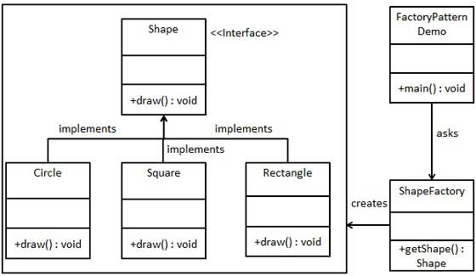
SOEN 6441 - Advanced Programming Practices
Factory pattern
The Factory pattern returns an instance of one of several possible classes depending on the data provided to it.
Here, Shape is a base class and classes Circle , Rectangle and Square are derived from it.
ShapeFactory is a class that decides which of these subclasses to return depending on the arguments you give it.
The getShape() method passes in some discriminating value, and returns some instance of one of the subclasses of the class x. Which one it returns doesn't matter to the programmer since they all have the same methods, but different implementations.
Joey Paquet, 2006-2014

Slide 13
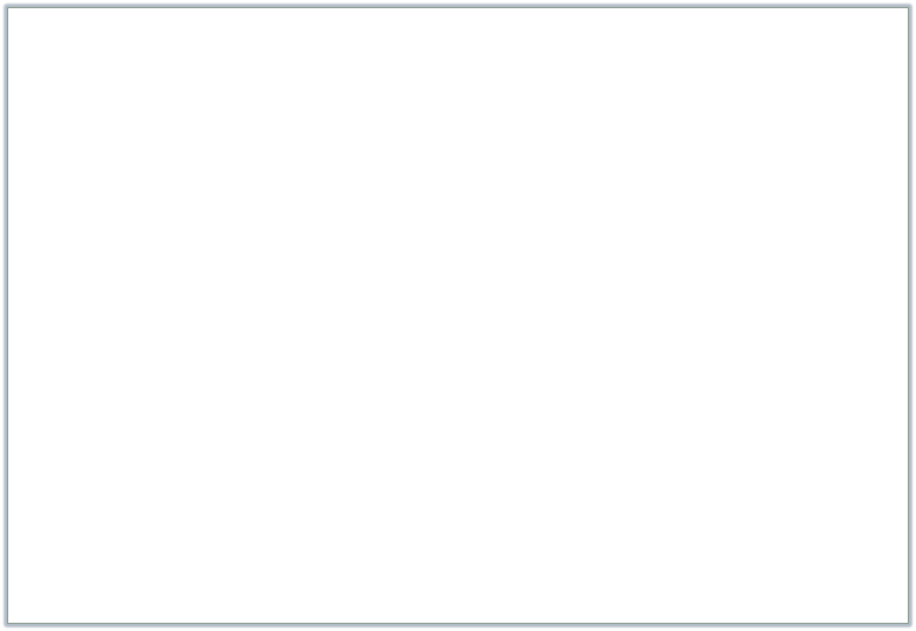
SOEN 6441 - Advanced Programming Practices
Factory pattern: example
/** Shape Factory that creates different kinds of Shape objects
* by calling its static factory method.
*/
public class ShapeFactory {
/**
* Constructor is made private to prevent instantiation
*/
private ShapeFactory (){};
/** Static method to create objects
* Change is required only in this function
* @param shapeType Variation factor of the Factory whose value determines
* what kind of shape will be created
* @return a Shape object whose type depends on the value of the variation factor
*/
static public Shape getShape(String shapeType){
if (shapeType.equalsIgnoreCase("CIRCLE")){
return new Circle();
} else if (shapeType.equalsIgnoreCase("RECTANGLE")){
return new Rectangle();
} else if (shapeType.equalsIgnoreCase("SQUARE")){
return new Square();
}
return null;
}
}
Joey Paquet, 2006-2014

Slide 14
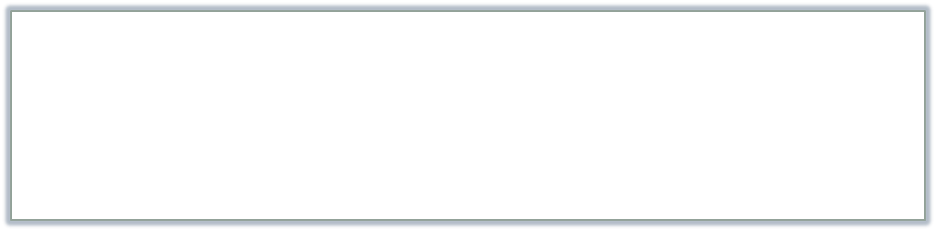


Factory pattern: example
SOEN 6441 - Advanced Programming Practices
/**
* Shape Interface (or Abstract class) that is the super-type of all
* types of objects produced by the ShapeFactory.
*/
public interface Shape {
void draw();
}
public class Rectangle implements Shape {
@Override
public void draw() {
System.out.println("Inside Rectangle::draw() method.");
}
}
public class Square extends Rectangle implements Shape {
@Override
public void draw() {
System.out.println("Inside Square::draw() method.");
}
}
public class Circle implements Shape {
@Override
public void draw() {
System.out.println("Inside Circle::draw() method.");
}
}
Joey Paquet, 2006-2014

Slide 15

Factory pattern: example
SOEN 6441 - Advanced Programming Practices
public class FactoryDriver {
public static void main(String[] args) {
//get an object of Circle and call its draw method.
Shape shape1 = ShapeFactory.getShape("CIRCLE");
//call draw method of Circle
shape1.draw();
//get an object of Rectangle and call its draw method.
Shape shape2 = ShapeFactory.getShape("RECTANGLE");
//call draw method of Rectangle
shape2.draw();
//get an object of Square and call its draw method.
Shape shape3 = ShapeFactory.getShape("SQUARE");
//call draw method of circle
shape3.draw();
}
}
Joey Paquet, 2006-2014

Slide 16
SOEN 6441 - Advanced Programming Practices
Factory pattern: context
You should consider using a Factory pattern when:
  Various kinds of objects are to be used polymorphically.
  A class uses a hierarchy of classes to specify which objects it creates.
  A class can’t anticipate the kind of objects it must create.
  You want to localize the knowledge of which class gets created.
How to recognize variations of the Factory pattern?
  The base class is (most often) abstract.
  The base class contains default methods and is only subclassed for cases where the default methods are insufficient.
  Parameters are passed to the factory telling it which of several class types to return.
  Classes may share the same method names but may do something quite different.
  Also often called a “factory method”.
Joey Paquet, 2006-2014

Slide 17
SOEN 6441 - Advanced Programming Practices
Builder pattern
Joey Paquet, 2006-2014

Slide 18
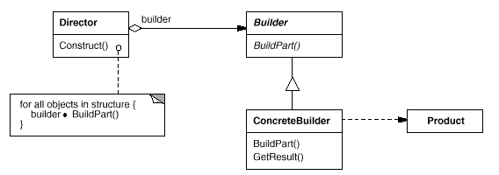
SOEN 6441 - Advanced Programming Practices
Builder pattern
The Builder Pattern separates the construction of a complex object from its representation so that the same construction process can create different representations.
Builder - specifies an abstract interface for creating parts of a Product object.
ConcreteBuilder - constructs and assembles parts of the product by implementing the Builder interface. Also, it defines and keeps track of the representation it creates and provides an interface for retrieving the product .
Director - constructs an object using the Builder interface.
Product - represents the complex object under construction.
Joey Paquet, 2006-2014

Slide 19
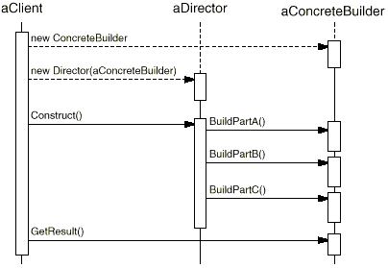
SOEN 6441 - Advanced Programming Practices
Builder pattern
The following interaction diagram illustrates how Builder and Director cooperate with a client.
The client creates the Director object and configures it with the desired Builder object.
Director notifies the builder whenever a part of the product should be built.
Builder handles requests from the director and adds parts to the product.
The client retrieves the product from the builder.
Joey Paquet, 2006-2014

Slide 20

Builder pattern: example
SOEN 6441 - Advanced Programming Practices
/**
* Product class of the Builder pattern
*/
public class Shelter {
/**
* The components of the shelter to be constructed
*/
private String roof, structure, floor;
/**
* Constructing the roof component
*/
public void setRoof(String newRoof){
roof = newRoof;
}
/**
* Constructing the structure component
*/
public void setStructure(String newStructure){
structure = newStructure;
}
/**
* Constructing the floor component
*/
public void setFloor(String newFloor){
floor = newFloor;
}
public String toString(){
return new String("roof= " + roof + "\nstructure= " + structure + "\nfloor= " + floor + "\n");
}
}
Joey Paquet, 2006-2014

Slide 21

Builder pattern: example
SOEN 6441 - Advanced Programming Practices
/**
* Abstract Builder class of the Builder pattern
*
*/
public abstract class ShelterBuilder {
/**
* Product to be constructed by the builder
*/
protected Shelter shelterProduct;
/**
* Get the constructed Shelter from the Builder
*/
public Shelter getShelter(){
return shelterProduct;
}
/**
* Create a new unspecified Shelter that
* will be eventually build by calling the
* following abstract methods in a concrete
* class derived from the Shelter class
*/
public void createNewShelter(){
shelterProduct = new Shelter();
}
abstract void buildRoof();
abstract void buildStructure();
abstract void buildFloor();
}
Joey Paquet, 2006-2014

Slide 22


Builder pattern: example
SOEN 6441 - Advanced Programming Practices
public class PolarShelterBuilder extends ShelterBuilder{
public void buildRoof(){ // Build the different parts of the Shelter
shelterProduct.setRoof("ice dome");
}
public void buildStructure(){ // The construction of the Shelter parts
shelterProduct.setStructure("ice blocks"); // depends on the type of Shelter being built
}
public void buildFloor(){ // The construction process in a real-life
shelterProduct.setFloor("caribou skin"); // example may be more complex.
}
}
public class TropicalShelterBuilder extends ShelterBuilder{
public void buildRoof(){
shelterProduct.setRoof("palm tree leaves"); // The construction process may vary
} // across the different Concrete Builders
public void buildStructure(){
shelterProduct.setStructure("bamboo");
}
public void buildFloor(){
shelterProduct.setFloor("goat skin");
}
}
Joey Paquet, 2006-2014

Slide 23

Builder pattern: example
SOEN 6441 - Advanced Programming Practices
/**
* Director of the Builder pattern
*
*/
public class Explorer {
/**
* The Explorer is to use a specific "build plan": the ShelterBuilder
*/
private ShelterBuilder builder;
public void setBuilder(ShelterBuilder newShelterBuilder) {
builder = newShelterBuilder;
}
/**
* The Director assumes that all Shelters have the same parts
* and each part is built by calling the same method
* though what these specific methods do may be different.
*/
public void constructShelter() {
builder.createNewShelter();
builder.buildRoof();
builder.buildStructure();
builder.buildFloor();
}
/**
* @return gets the Shelter after it has been built
*/
public Shelter getShelter() {
return builder.getShelter();
}
}
Joey Paquet, 2006-2014

Slide 24

Builder pattern: example
SOEN 6441 - Advanced Programming Practices
/**
* Driver class for the Shelter Builder Example
*
*/
public class Expedition {
public static void main(String[] args){
Explorer explorer;
Shelter hut, igloo;
ShelterBuilder tropicalBuilder = new TropicalShelterBuilder();
ShelterBuilder polarBuilder = new PolarShelterBuilder();
explorer = new Explorer();
explorer.setBuilder(tropicalBuilder);
explorer.constructShelter();
hut = explorer.getShelter();
System.out.println(hut);
explorer.setBuilder(polarBuilder);
explorer.constructShelter();
igloo = explorer.getShelter();
System.out.println(igloo);
}
}
Joey Paquet, 2006-2014

Slide 25
SOEN 6441 - Advanced Programming Practices
Builder pattern: context
Use the Builder pattern when:
  The algorithm for creating a complex object should be independent of the parts that make up the object and how they are assembled.
  The construction process must allow different representations for the object that is constructed.
  Complex objects need to be created that have a common overall structure and interface, even though their internal behavior and detailed structure may be different.
Joey Paquet, 2006-2014

Slide 26
SOEN 6441 - Advanced Programming Practices
Builder pattern: consequences
A Builder lets you vary the internal representation of the product it builds. It also hides the details of how the product is assembled. It provides construction abstraction.
Each specific builder is independent of the others and of the rest of the program. This improves modularity and makes the addition of other builders relatively simple.
Because each builder constructs the final product step-by-step, you have more control over each final product that a Builder constructs.
Joey Paquet, 2006-2014

Slide 27
SOEN 6441 - Advanced Programming Practices
Singleton pattern
Joey Paquet, 2006-2014

Slide 28
SOEN 6441 - Advanced Programming Practices
Singleton pattern
Sometimes it is appropriate to have exactly one instance of a class:
  window managers,
  print spoolers,
  filesystems.
Typically, those types of objects known as singletons, are accessed by disparate objects throughout a software system, and therefore require a global point of access.
The Singleton pattern addresses all the concerns above. With the Singleton design pattern you can:
  Ensure that only one instance of a class is created.
  Provide a global point of access to the object.
  Allow multiple instances in the future without affecting a singleton class' clients.
Joey Paquet, 2006-2014

Slide 29
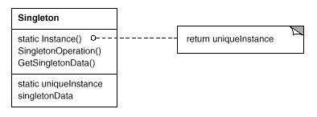
SOEN 6441 - Advanced Programming Practices
Singleton pattern
The Singleton pattern ensures a class has only one instance, and provides a global point of access to it.
The class itself is responsible for keeping track of its sole instance. The class can ensure that no other instance can be created (by intercepting requests to create new objects), and it can provide a way to access the instance.
Singletons maintain a static reference to the sole singleton instance and return a reference to that instance from a static instance() method.
Joey Paquet, 2006-2014

Slide 30


Singleton pattern
SOEN 6441 - Advanced Programming Practices
public class SingleObject {
/**
* create an object of SingleObject embedded as a static member of the class itself
*/
private static SingleObject instance = new SingleObject();
/**
* Make the constructor private so that this class cannot be instantiated
*/
private SingleObject(){}
/**
* If the instance was not previously created, create it. Then return the instance
*/
public static SingleObject getInstance(){
if (instance == null)
instance = new SingleObject();
return instance;
}
public void showMessage(){
System.out.println("Hello World!");
}
}
public class SingletonDriver {
public static void main(String[] args) {
//Get the only object available
SingleObject object = SingleObject.getInstance();
//use the Singleton
object.showMessage();
}
}
Joey Paquet, 2006-2014

Slide 31
SOEN 6441 - Advanced Programming Practices
Singleton
The Singleton class employs a technique known as lazy instantiation to create the singleton; as a result, the singleton instance is not created until the Instance() method is called for the first time. This technique ensures that the singleton instance iscreated only when needed.
The Singleton class implements a protected constructor so clients cannot instantiate Singleton instances.
Protected constructors allow Singleton subclasses to be created.
Even though the Singleton is an interesting pattern, it is essentially a global variable, and as such should be used with caution.
Joey Paquet, 2006-2014

Slide 32
SOEN 6441 - Advanced Programming Practices
Structural patterns
Joey Paquet, 2006-2014

Slide 33
SOEN 6441 - Advanced Programming Practices
Structural patterns
Structural patterns describe how classes and objects can be combined to form larger structures.
The difference between class patterns and object patterns is that class patterns describe how inheritance can be used to provide more useful program interfaces.
Object patterns, on the other hand, describe how objects can be composed into larger structures using object composition, or the inclusion of objects within other objects.
Some of the Structural patterns are:
  Adapter
  Composite
  Façade
  Bridge
  Decorator
  Flyweight
Joey Paquet, 2006-2014

Slide 34
SOEN 6441 - Advanced Programming Practices
Structural patterns
The Adapter Pattern is used to allow a client class to use another class that may provide a service to it, but whose API is incompatible with what the client is expecting.
The Flyweight pattern is a pattern for sharing objects, where each instance does not contain its own state, but stores it externally. This allows efficient sharing of objects to save space, when there are many instances, but only a few different types.
The Façade pattern is used to make a single class represent an entire subsystem.
The Decorator pattern can be used to add features to objects dynamically.
Joey Paquet, 2006-2014

Slide 35
SOEN 6441 - Advanced Programming Practices
Adapter pattern
Joey Paquet, 2006-2014

Slide 36
SOEN 6441 - Advanced Programming Practices
Adapter pattern
Motivation
  Like any adapter in the real world it is used to be an interface, a bridge between two objects that have the same functionality, but that are to be used in a different manner, i.e. have a different specification to their interfaces. In real world we have adapters for power supplies, adapters for camera memory cards, and so on.
  The same concept applies to software components. You may have some class expecting some type of object and you have an object offering the same features, but exposing a different interface. You don't want to change existing classes, so you want to create an adapter.
Intent
  Convert the interface of a class into another interface that clients expect.
  Adapter lets classes work together, that could not otherwise because of incompatible interfaces.
Joey Paquet, 2006-2014

Slide 37
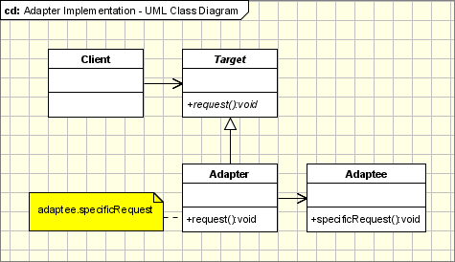
SOEN 6441 - Advanced Programming Practices
Adapter pattern: structure
The classes/objects participating in adapter pattern:
  Target - defines the domain-specific interface that Client uses.
  Adapter - adapts the interface Adaptee to the Target interface.
  Adaptee - defines an existing interface that needs adapting.
  Client - collaborates with objects conforming to the Target interface.
Joey Paquet, 2006-2014

Slide 38
SOEN 6441 - Advanced Programming Practices
Adapter pattern
The adapter pattern is used:
  When you have a class (Target) that invokes methods defined in an interface and you have a another class (Adaptee) that doesn't implement the interface but implements the operations that should be invoked from the first class through the interface.
  You can change none of the existing code.
  You need an adapter to implement the interface that will be the bridge between the two classes.
Joey Paquet, 2006-2014

Slide 39


SOEN 6441 - Advanced Programming Practices
Adapter pattern: example
If a client only understands the SquarePeg interface for inserting pegs using the insert() method, how can it insert round pegs, which are pegs, but that are inserted differently, using the insertIntoHole() method?
/**
* The SquarePeg class. This is the Target class.
*/
public class SquarePeg {
/**
* This is the interface that the client class knows about Pegs
*/
public void insert(String str) {
System.out.println("SquarePeg insert(): " + str);
}
}
/**
* The RoundPeg class. This is the Adaptee class.
*/
public class RoundPeg {
/**
* The client does not know this interface, though
* it provides the service that the client wants.
*/
public void insertIntoHole(String msg) {
System.out.println("RoundPeg insertIntoHole(): " + msg);
}
}
Joey Paquet, 2006-2014

Slide 40

SOEN 6441 - Advanced Programming Practices
Adapter pattern: example
Solution:
  Design a SquareToRoundPeg adapter that enables to insertIntoHole() a RoundPeg object connected to the adapter to be inserted as a SquarePeg, using insert().
/**
* The SquareToRoundPegAdapter class. This is the Adapter class.
* It adapts a SquarePeg to a RoundPeg. Its interface is that of a SquarePeg.
*/
public class SquareToRoundPegAdapter extends SquarePeg {
/**
* The adapter contains the RoundPeg Adaptee
*/
private RoundPeg roundPeg;
/**
* Upon creation, the Adapter is plugged into the RoundPeg Adaptee
*/
public SquareToRoundPegAdapter(RoundPeg peg) {
//the roundPeg is plugged into the adapter
this.roundPeg = peg;}
/**
* The Adapter provides the Target's method and translates it
* to the corresponding Adaptee's method call.
*/
public void insert(String str) {
//the roundPeg can now be inserted in the same manner as a squarePeg!
roundPeg.insertIntoHole(str);}
}
Joey Paquet, 2006-2014

Slide 41


SOEN 6441 - Advanced Programming Practices
Adapter pattern: example
/**
* Driver program using the Peg Adapter
*/
public class AdapterDriver{
public static void main(String args[]) {
// Create some pegs.
RoundPeg roundPeg = new RoundPeg();
SquarePeg squarePeg = new SquarePeg();
// Do an insert using the square peg (standard).
squarePeg.insert("I am a SquarePeg in a square hole.");
// Now we'd like to do an insert using the round peg.
// But this client only understands the insert()
// method of pegs, not a insertIntoHole() method.
// The solution: create an adapter that adapts
// a square peg to a round peg!
SquarePeg wannabeRound = new SquareToRoundPegAdapter(roundPeg);
wannabeRound.insert("I am a SquarePeg in a round hole!");}
}
SquarePeg insert(): I am a SquarePeg in a square hole.
RoundPeg insertIntoHole(): I am a SquarePeg in a round hole!
Joey Paquet, 2006-2014

Slide 42
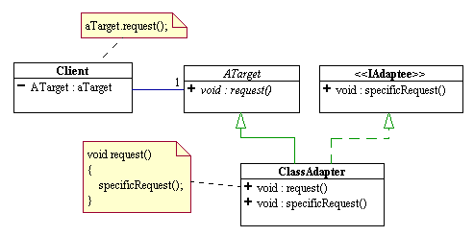
Class adapter: example
SOEN 6441 - Advanced Programming Practices
Class adapters use multiple inheritance to achieve their goals.
As in the object adapter, the class adapter inherits the interface of the client's Target class. However, it also inherits the interface of the Adaptee as well.
Since Java does not support true multiple inheritance, this means that one of the interfaces must be inherited from a Java interface type.
Both of the Target or Adaptee interfaces could be Java interfaces.
The request to the Target is simply rerouted to the specific request that was inherited from the Adaptee interface.
Joey Paquet, 2006-2014

Slide 43




Class adapter: example
SOEN 6441 - Advanced Programming Practices
/**
* The IRoundPeg interface.
*/
public interface IRoundPeg {
public void insertIntoHole(String msg);
}
/**
* The RoundPeg Target/Adaptee class.
*/
public class RoundPeg implements IRoundPeg {
public void insertIntoHole(String msg) {
System.out.println("RoundPeg insertIntoHole(): " + msg);}
}
/**
* The ISquarePeg interface.
*/
public interface ISquarePeg {
public void insert(String str);
}
/**
* The SquarePeg Target/Adaptee class.
*/
public class SquarePeg implements ISquarePeg {
public void insert(String str) {
System.out.println("SquarePeg insert(): " + str);}
}
Joey Paquet, 2006-2014

Slide 44

Class adapter: example
SOEN 6441 - Advanced Programming Practices
/**
* The PegAdapter class. This is a two-way adapter class.
*/
public class PegAdapter implements ISquarePeg, IRoundPeg {
private RoundPeg roundPeg;
private SquarePeg squarePeg;
public PegAdapter(RoundPeg peg) {
this.roundPeg = peg;}
public PegAdapter(SquarePeg peg) {
this.squarePeg = peg;}
public void insert(String str) {
roundPeg.insertIntoHole(str);}
public void insertIntoHole(String msg){
squarePeg.insert(msg);}
}
Joey Paquet, 2006-2014

Slide 45


Class adapter: example
SOEN 6441 - Advanced Programming Practices
/**
* Driver class for two way Peg Adapter.
*/
public class TwoWayAdapterDriver {
public static void main(String args[]) {
// Create some pegs.
RoundPeg roundPeg = new RoundPeg();
SquarePeg squarePeg = new SquarePeg();
// Do an insert using the square peg.
squarePeg.insert("I am a SquarePeg into a square hole.");
// Create a two-way adapter and do an insert with it.
ISquarePeg wannabeRound = new PegAdapter(roundPeg);
wannabeRound.insert("I am a SquarePeg into a round hole!");
// Do an insert using the round peg.
roundPeg.insertIntoHole("I am a RoundPeg into a round hole.");
// Create a two-way adapter and do an insert with it.
IRoundPeg wannabeSquare = new PegAdapter(squarePeg);
wannabeSquare.insertIntoHole("I am a RoundPeg into a square hole!");}
}
SquarePeg insert(): I am a SquarePeg into a square hole.
RoundPeg insertIntoHole(): I am a SquarePeg into a round hole!
RoundPeg insertIntoHole(): I am a RoundPeg into a round hole.
SquarePeg insert(): I am a RoundPeg into a square hole!
Joey Paquet, 2006-2014

Slide 46
SOEN 6441 - Advanced Programming Practices
Decorator pattern
Joey Paquet, 2006-2014

Slide 47
Decorator pattern
SOEN 6441 - Advanced Programming Practices
Motivation:
  Sometimes we may want to dynamically add some data members or methods to an object at runtime, depending on the situation.
Intent:
  Allow to add new functionality to an existing object without altering its structure.
  Create a Decorator class that wraps the original class.
  Provides additional functionality while keeping the class’ methods’ signatures intact.
Joey Paquet, 2006-2014

Slide 48
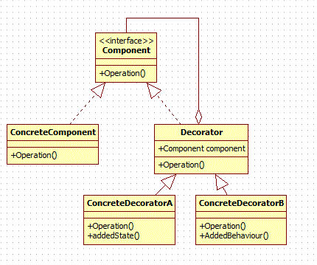
Decorator pattern
SOEN 6441 - Advanced Programming Practices
Elements of the Decorator pattern:
  Component: Abstract class representing the objects to be decorated by the various Decorators.
  Concrete Component: The potentially many sub-classes that can be decorated.
  Decorator: Abstract class that wraps a Component and will have some of its subclasses to decorate it.
  Concrete Decorator: Different decorators that add different members to the Component.
Joey Paquet, 2006-2014

Slide 49



Decorator pattern: example
SOEN 6441 - Advanced Programming Practices
/**
* The abstract Coffee class defines the functionality of any Coffee
* implemented by subclasses of Coffee
*/
public abstract class Coffee {
public abstract double getCost();
public abstract String getIngredients();
}
/**
* Kind of Coffee
*/
public class Espresso extends Coffee {
public double getCost() {
return 1.25;
}
public String getIngredients() {
return "Strong Coffee";
}
}
/**
* Kind of Coffee
*/
public class SimpleCoffee extends Coffee {
public double getCost() {
return 1;
}
public String getIngredients() {
return "Coffee";
}
}
Joey Paquet, 2006-2014

Slide 50

Decorator pattern: example
SOEN 6441 - Advanced Programming Practices
/**
* Abstract decorator class - note that it extends the Coffee abstract class
*/
public abstract class CoffeeDecorator extends Coffee {
protected final Coffee decoratedCoffee;
/**
* Wraps a Coffee object inside an object of one of
* CoffeeDecorator's subclasses
*/
public CoffeeDecorator (Coffee decoratedCoffee) {
this.decoratedCoffee = decoratedCoffee;
}
/**
* Provides the wrapper with the Coffee interface and delegates
* its methods to the wrapped Coffee object.
*/
public double getCost() {
return decoratedCoffee.getCost();
}
public String getIngredients() {
return decoratedCoffee.getIngredients();
}
}
Joey Paquet, 2006-2014

Slide 51

Decorator pattern: example
SOEN 6441 - Advanced Programming Practices
/** Decorator that mixes Milk with coffee.
* It is a subclass of CoffeeDecorator, and thus a subclass of Coffee.
*/
class Milk extends CoffeeDecorator {
/**
* When creating a decorated Coffee, pass a Coffee to be decorated
* as a parameter. Note that this can be an already-decorated Coffee.
*/
public Milk (Coffee decoratedCoffee) {
super(decoratedCoffee);
}
/**
* Overriding methods defined in the abstract superclass.
* Enables to provide different behavior for decorated Coffee methods
*/
public double getCost() {
return super.getCost() + 0.5;
}
public String getIngredients() {
return super.getIngredients() + ", Milk";
}
/**
* May also add additional members for decorated-specific data
* or behavior
*/
}
Joey Paquet, 2006-2014

Slide 52


Decorator pattern: example
SOEN 6441 - Advanced Programming Practices
class Sprinkles extends CoffeeDecorator {
public Sprinkles (Coffee decoratedCoffee) {
super(decoratedCoffee);
}
public double getCost() {
return super.getCost() + 0.2;
}
public String getIngredients() {
return super.getIngredients() + ", Sprinkles";
}
}
class Whip extends CoffeeDecorator {
public Whip (Coffee decoratedCoffee) {
super(decoratedCoffee);
}
public double getCost() {
return super.getCost() + 0.7;
}
public String getIngredients() {
return super.getIngredients() + ", Whip";
}
}
Joey Paquet, 2006-2014

Slide 53


Decorator pattern: example
SOEN 6441 - Advanced Programming Practices
public class DecoratorDriver {
public static final void main(String[] args) {
Coffee c = new SimpleCoffee();
System.out.println("Cost: " + c.getCost() + "; Ingredients: " + c.getIngredients());
c = new Milk(c);
System.out.println("Cost: " + c.getCost() + "; Ingredients: " + c.getIngredients());
c = new Sprinkles(c);
System.out.println("Cost: " + c.getCost() + "; Ingredients: " + c.getIngredients());
c = new Whip(c);
System.out.println("Cost: " + c.getCost() + "; Ingredients: " + c.getIngredients());
// Note that you can also stack more than one decorator of the same type
c = new Sprinkles(c);
System.out.println("Cost: " + c.getCost() + "; Ingredients: " + c.getIngredients());
c = new Espresso();
System.out.println("Cost: " + c.getCost() + "; Ingredients: " + c.getIngredients());
c = new Milk(c);
System.out.println("Cost: " + c.getCost() + "; Ingredients: " + c.getIngredients());
}
}
Cost: 1.0; Ingredients: Coffee
Cost: 1.5; Ingredients: Coffee, Milk
Cost: 1.7; Ingredients: Coffee, Milk, Sprinkles
Cost: 2.4; Ingredients: Coffee, Milk, Sprinkles, Whip
Cost: 2.6; Ingredients: Coffee, Milk, Sprinkles, Whip, Sprinkles
Cost: 1.25; Ingredients: Strong Coffee
Cost: 1.75; Ingredients: Strong Coffee, Milk
Joey Paquet, 2006-2014

Slide 54
SOEN 6441 - Advanced Programming Practices
Behavioral patterns
Joey Paquet, 2006-2014

Slide 55
SOEN 6441 - Advanced Programming Practices
Observer pattern
Joey Paquet, 2007-2014

Slide 56
Observer pattern: motivation, intent
SOEN 6441 - Advanced Programming Practices
Motivation
  The cases when certain objects need to be informed about the changes occurring in other objects are frequent. To have a good design means to decouple as much as possible and to reduce the dependencies. The Observer Design Pattern can be used whenever a subject has to be observed by one or more observers.
Intent
  Define a one-to-many dependency between objects so that when one object changes state, all its dependents are notified and updated automatically.
This pattern is a cornerstone of the Model-View-Controller architectural design, where the Model implements the mechanics of the program, and the Views are implemented as Observers that are as much uncoupled as possible from the Model components.
Joey Paquet, 2007-2014

Slide 57
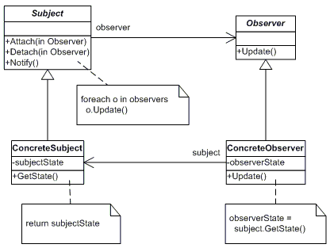
Observer pattern: design
SOEN 6441 - Advanced Programming Practices
“Model” classes
“View” classes
Joey Paquet, 2007-2014

Slide 58
Observer pattern: design
SOEN 6441 - Advanced Programming Practices
The participants classes in the Observer pattern are:
  Subject - interface or abstract class defining the operations for attaching and de-attaching observers to the client. It is often referred to as “Observable”.
  ConcreteSubject - concrete Subject class. It maintain the state of the observed object and when a change in its state occurs it notifies the attached Observers. If used as part of MVC, the ConcreteSubject classes are the Model classes that have Views attached to them.
  Observer - interface or abstract class defining the operations to be used to notify the registered Observer objects.
  ConcreteObserver - concrete Observer subclasses that are attached to a particular Subject class. There may be different concrete observers attached to a single Subject that will provide a different view of that Subject.
Joey Paquet, 2007-2014

Slide 59
Observer pattern: behavior
SOEN 6441 - Advanced Programming Practices
Behavior
  The client class instantiates the ConcreteObservable object.
  Then it instantiates and attaches the concrete observers to it using the methods defined in the Observable interface.
  Each time the (observable) state of the subject is changing, it notifies all the attached Observers using the methods defined in the Observer interface.
  When a new Observer is added to the application, all we need to do is to instantiate it in the client class and to add attach it to the Observable object.
  The classes already created will remain mostly unchanged.
Joey Paquet, 2007-2014

Slide 60

Observer pattern: implementation
SOEN 6441 - Advanced Programming Practices
Model classes need to be made subclasses of the Observable Java class.
When a part of their state that is observed is changed, call the setChanged() method to specify that the observed object’s state has been changed, then the notifyObservers() method that will notify all the attached observers by calling their update() method.
import java.util.Observable;
class ClockTimerModel extends Observable {
public
int GetHour(){return hour;};
int GetMinute(){return minute;};
int GetSecond(){return second;};
void tick(){
// update internal state
second ++;
if (second >= 60){
minute++; second = 0;
if (minute >= 60){
hour++; minute=0;
if (hour >= 24){
hour=0;
};
};
};
// specify that my state was changed
setChanged();
// notify all attached Observers of a change
notifyObservers(this);
};
void start(int secs){
for (int i = 1; i <= secs; i++)
tick();
};
private
int hour;
int minute;
int second;
};
Joey Paquet, 2007-2014

Slide 61

Observer pattern: implementation
SOEN 6441 - Advanced Programming Practices
View classes are subclasses of the Java Observer abstract class.
They need to implement the update() method that is called by the notifyObservers() method of the Observable class.
This method does the necessary updates to the view offered to the user (here a simple console output).
import java.util.Observable;
import java.util.Observer;
class DigitalClockView implements Observer {
public
void update(Observable obs, Object x) {
//redraw my clock’s reading after I was notified
int hour = ((ClockTimerModel) obs).GetHour();
int minute = ((ClockTimerModel) obs).GetMinute();
int second = ((ClockTimerModel) obs).GetSecond();
System.out.println(hour+":"+minute+":"+second);
};
};
Joey Paquet, 2007-2014

Slide 62

Observer pattern: implementation
SOEN 6441 - Advanced Programming Practices
The main program must:
Create the Model object.
Create the View object.
Connect the View object to the Model object.
Then, any change in the state of the Model object triggers the update of the Views attached to it.
import java.util.Scanner;
public class ObserverDemo extends Object {
DigitalClockView clockView;
ClockTimerModel clockModel;
public ObserverDemo() {
//create the View object
clockView = new DigitalClockView();
//create the Model object
clockModel = new ClockTimerModel();
//connect the View object to the Model object
clockModel.addObserver(clockView);
};
public static void main(String[] av) {
ObserverDemo od = new ObserverDemo();
od.demo();
};
public void demo() {
Scanner kbd = new Scanner(System.in);
int secs = kbd.nextInt();
clockModel.start(secs);
kbd.close();
};
};
Joey Paquet, 2007-2014

Slide 63
SOEN 6441 - Advanced Programming Practices
Strategy pattern
Joey Paquet, 2006-2014

Slide 64
Strategy pattern
SOEN 6441 - Advanced Programming Practices
Motivation:
  Sometimes we may want to change the behavior of an object depending on some conditions that are only to be determined at runtime, or to easily add new definitions of a certain behavior without altering the class that is using it.
Intent:
  Define a group of algorithms that applies to a family of classes
  Encapsulate each algorithm separately
  Make the algorithms interchangeable within that family
Consequence:
  The Strategy Pattern lets the specific algorithm implemented by a method vary without affecting the clients that use it.
Joey Paquet, 2006-2014

Slide 65
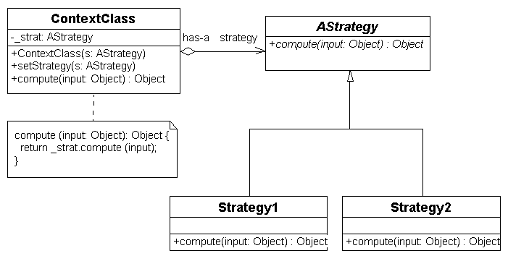
Strategy pattern
SOEN 6441 - Advanced Programming Practices
Elements of the strategy pattern:
  Context Class: class that uses a certain behavior that is to be changed during execution. It contains a Strategy object and provides a setStrategy() method to change its own strategy. The strategy is to be called through a compute() method that will delegate to a concrete strategy method.
  Strategy Abstract Class: Superclass of all strategies containing the abstract compute() method to be implemented by all its subclasses.
  Concrete Strategies: Subclasses of Strategy that provide a different implementation for the compute() method.
Joey Paquet, 2006-2014

Slide 66

Strategy pattern: example
SOEN 6441 - Advanced Programming Practices
/** Class configured with a ConcreteStrategy object and maintains
* a reference to a Strategy object. Depending on which strategy is
* plugged in, it will execute a different operation.
*/
class Calculator {
private Strategy strategy;
/**
* Plugs in a specific strategy to be used
*/
public void setStrategy(Strategy strategy) {
this.strategy = strategy;
}
/**
* Method that executes a different strategy depending on what strategy was
* plugged in upon instantiation.
*/
public int executeStrategy(int a, int b) {
return this.strategy.execute(a, b);
}
}
Joey Paquet, 2006-2014

Slide 67




Strategy pattern: example
SOEN 6441 - Advanced Programming Practices
/**
* The classes that implement a concrete strategy should implement this.
* The Calculator class uses this to use a concrete strategy.
*/
interface Strategy {
/**
* Method whose implementation varies depending on the strategy adopted.
*/
int execute(int a, int b);
}
/**
* A concrete Strategy that implements a addition operation
*/
class Add implements Strategy {
public int execute(int a, int b) {
System.out.println("Called Add's execute()");
return a + b; // Do an addition with a and b
}
}
/**
* A concrete Strategy that implements a subtraction operation
*/
class Subtract implements Strategy {
public int execute(int a, int b) {
System.out.println("Called Subtract's execute()");
return a - b; // Do a subtraction with a and b
}
}
/**
* A concrete Strategy that implements a multiplication operation
*/
class Multiply implements Strategy {
public int execute(int a, int b) {
System.out.println("Called Multiply's execute()");
return a * b; // Do a multiplication with a and b
}
}
Joey Paquet, 2006-2014

Slide 68

Strategy pattern: example
SOEN 6441 - Advanced Programming Practices
/**
* Driver class to test the Strategy pattern
*/
class StrategyExample {
public static void main(String[] args) {
Calculator calculator = new Calculator();
// Three contexts following different strategies
calculator.setStrategy(new Add());
int resultA = calculator.executeStrategy(3,4);
System.out.println("Result A : " + resultA );
calculator.setStrategy(new Subtract());
int resultB = calculator.executeStrategy(3,4);
System.out.println("Result B : " + resultB );
calculator.setStrategy(new Multiply());
int resultC = calculator.executeStrategy(3,4);
System.out.println("Result C : " + resultC );
}
}
Joey Paquet, 2006-2014

